Slide 1
Sudoku with multiplayer by LAN
GUI design and Class design
Kh.Serikjan, B.Batkhuu IT3-1

Slide 2
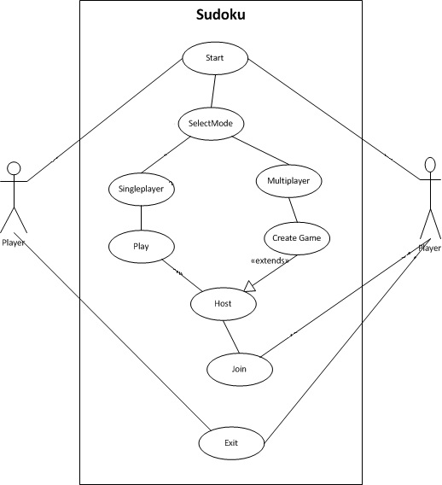
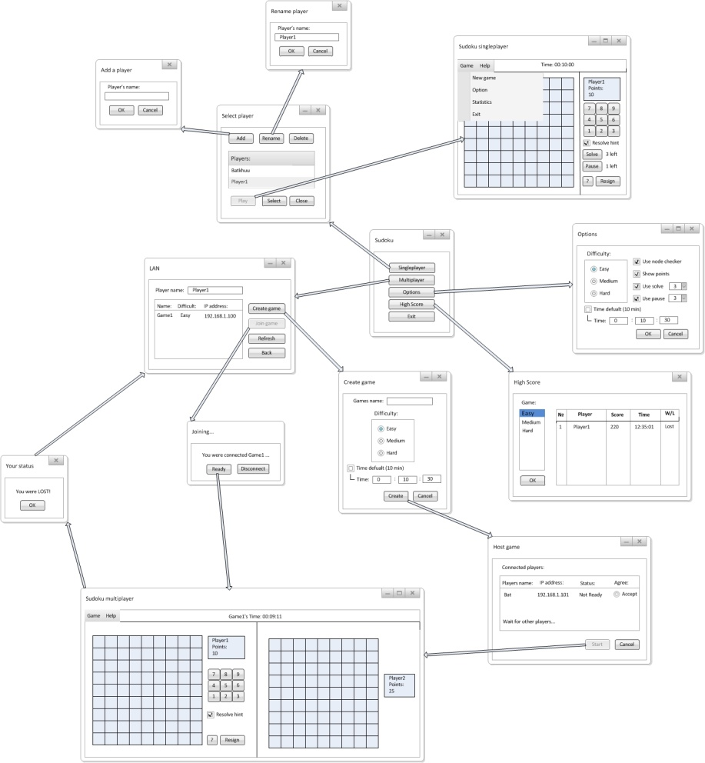
Use case and GUI design

Slide 3
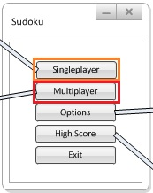
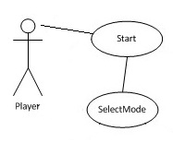


Use Case processes with GUI design
1. Start and SelectMode:
Click on icon to start sudoku
Choose your Play mode

Slide 4
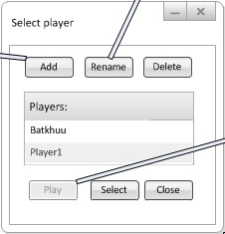

Use Case processes with GUI design
2. Singleplayer:
Select player or add a new player
Click on Play

Slide 5
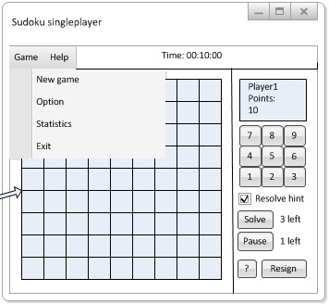

Use Case processes with GUI design
3.a. Play (Singleplayer):
Solve node’s right number before time
All nodes solved then you win

Slide 6
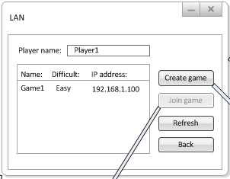

Use Case processes with GUI design
4. Multiplayer:
Enter your name
Select and join in available game from list (Only in LAN)
Or create your new game

Slide 7
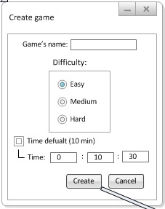

Use Case processes with GUI design
5. Create Game:
Enter game name
Select difficulty
Optional: Set game time
Click on Start button

Slide 8
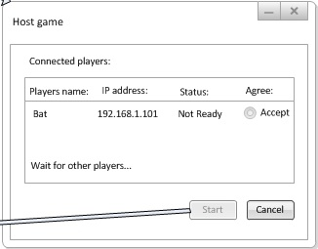

Use Case processes with GUI design
5. Host:
Wait for other player to connect…
Accept only one ready player (1vs1)
Click on Start button

Slide 9

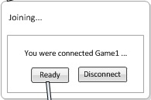
Use Case processes with GUI design
5. Join:
Enter your name
Select and join in available game from list
Click on ready button and wait for host to start… then play!

Slide 10
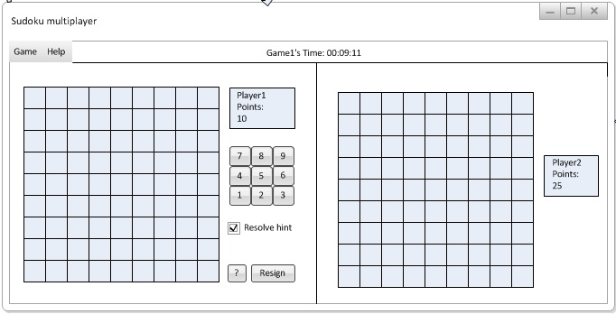
Use Case processes with GUI design
3.b. Play (Multiplayer):
In Multiplayer mode little different from Singleplayer mode
Solve all node’s right number from your opponent in time!

Slide 11
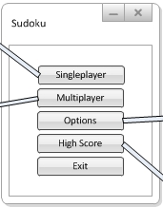
GUI design
1. Start Sudoku

Slide 12
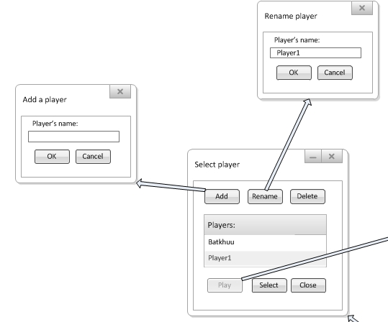
GUI design
2. Sudoku – Singleplayer: Select player

Slide 13
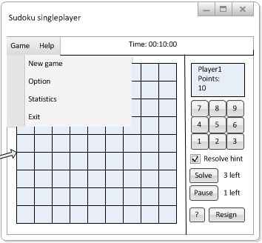
GUI design
3. Select player – Play: Sudoku Singleplayer

Slide 14
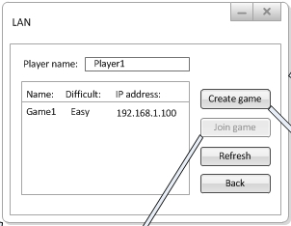
GUI design
4. Sudoku - Multiplayer: LAN

Slide 15
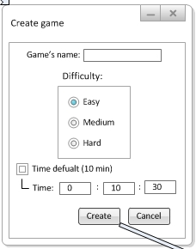
GUI design
5. LAN – Create game: Create game

Slide 16
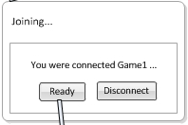
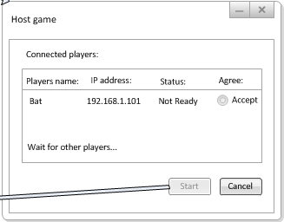
GUI design
6. LAN - Join game: Joining
7. Create game - Create: Host game

Slide 17
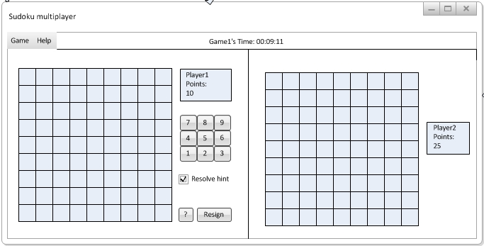
GUI design
8. Host game – Start, Joining – Ready:
Sudoku multiplayer

Slide 18
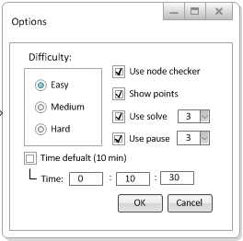
GUI design
9. Sudoku - Options: Options

Slide 19
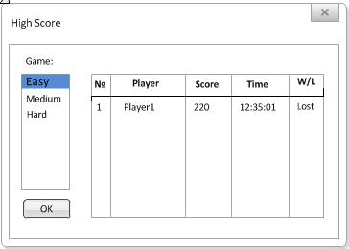
GUI design
10. Sudoku – High Score: High Score

Slide 20
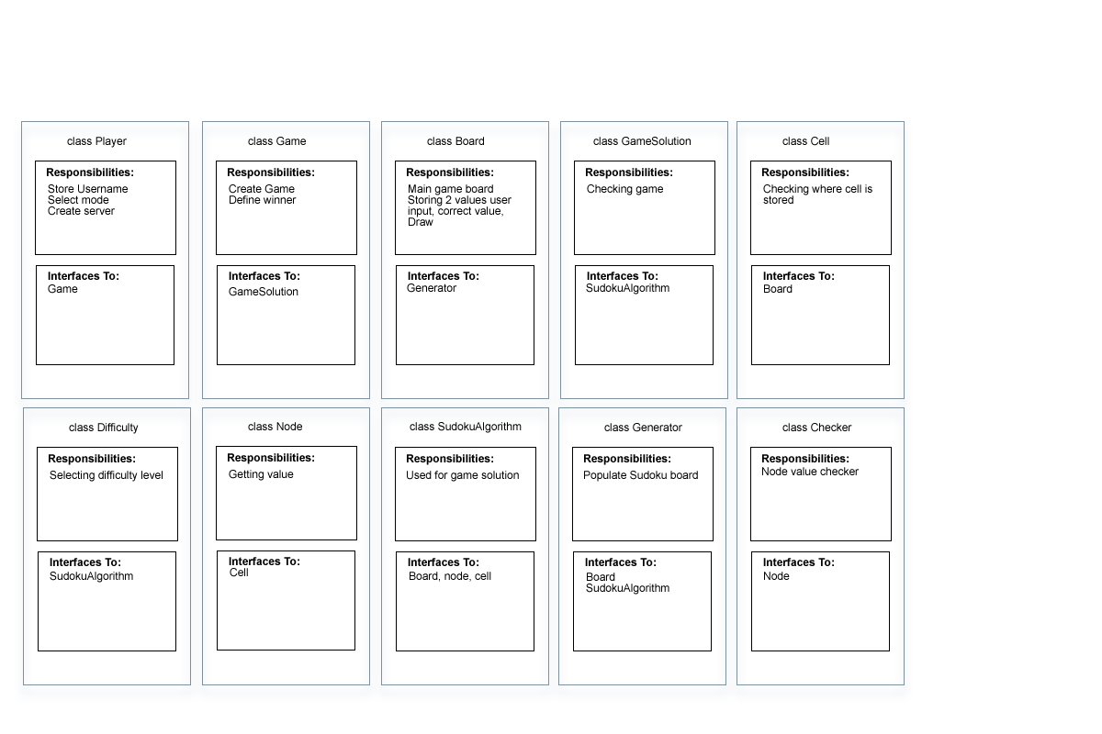
Class design

Slide 21
Any questions?
Thanks for your attention

